Slide 1

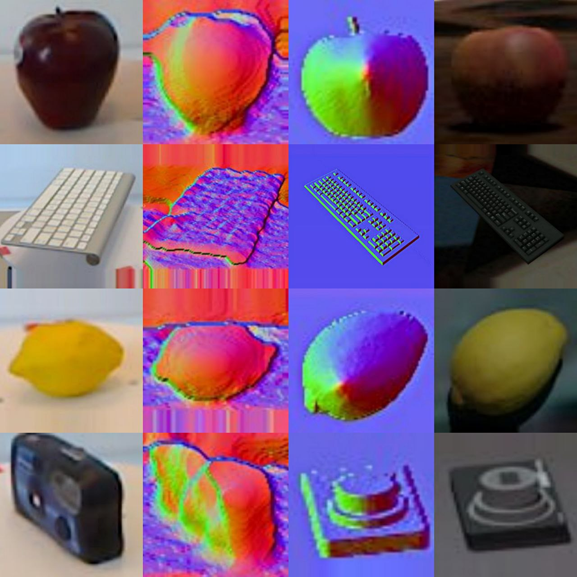
Unsupervised Domain Adaptation Through Multi Task Recognition for RGB-D Object Recognition Gaetano Salvatore Falco Kuerxi Gulisidan
1

Slide 2
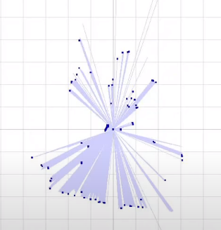
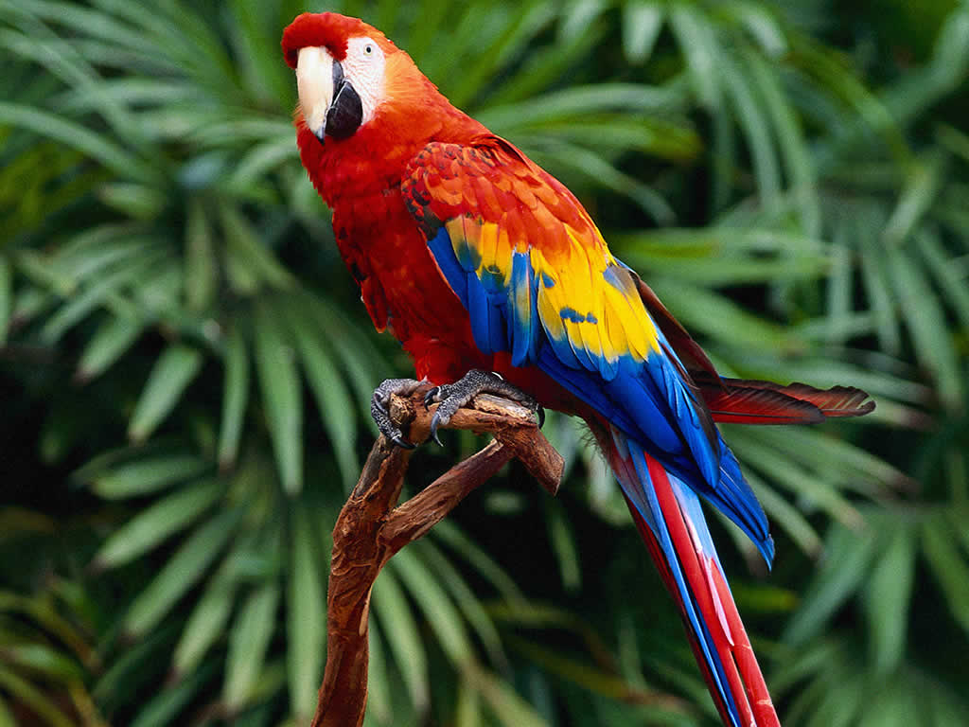
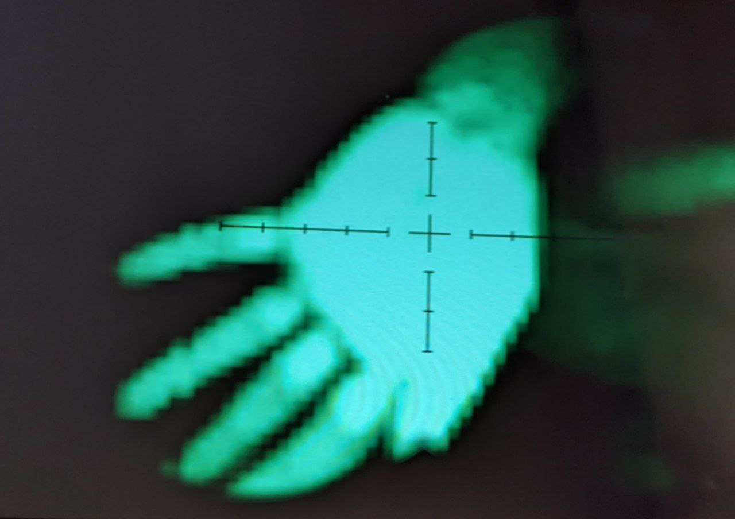
What are RGB images? What are Depth images?
Introduction
Method
Results
Related work
Conclusion
2

Slide 3
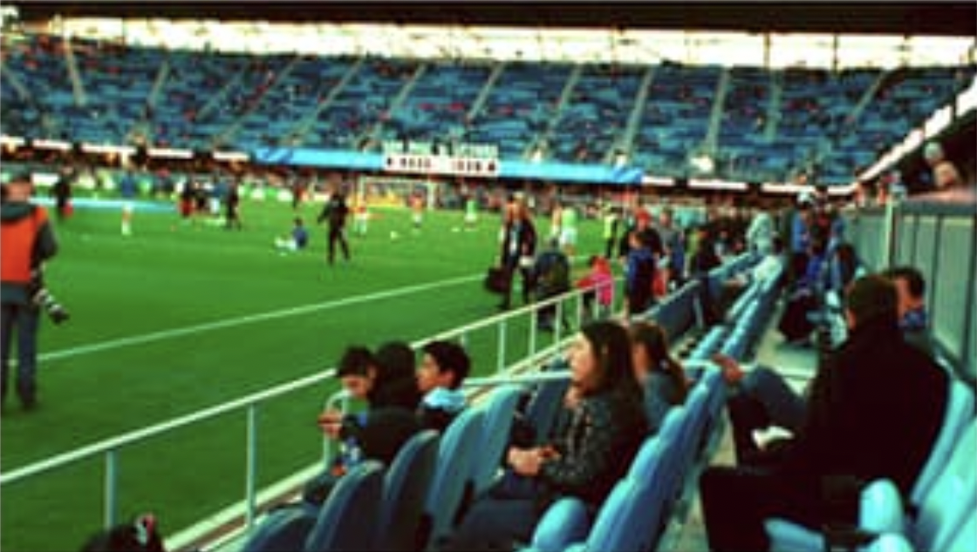
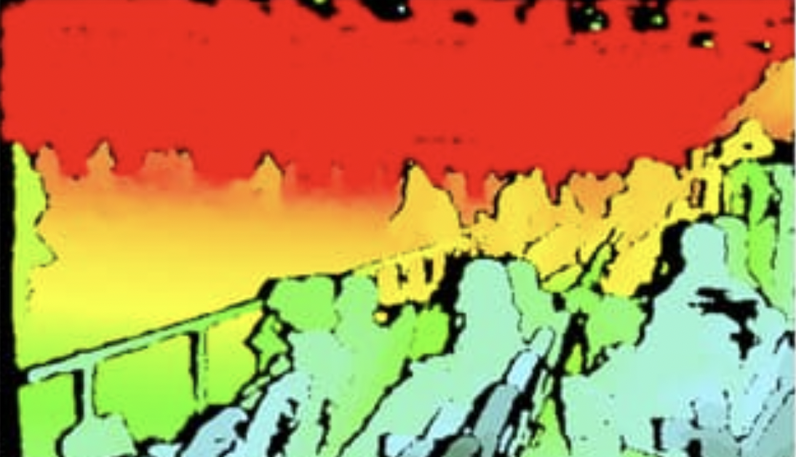
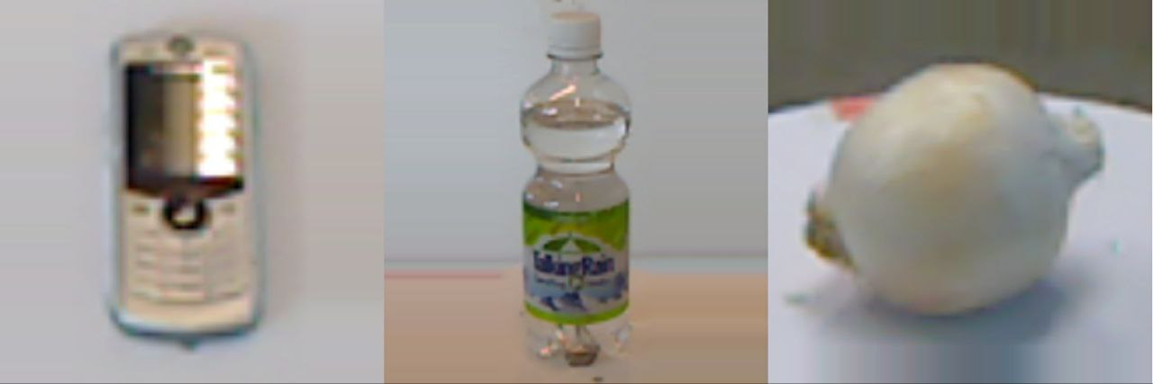
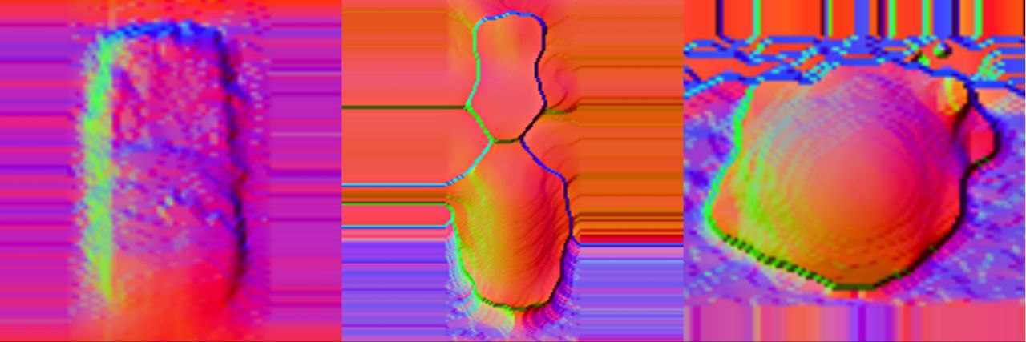
Can we combine this information?
Introduction
Method
Results
Related work
Conclusion
3

Slide 4
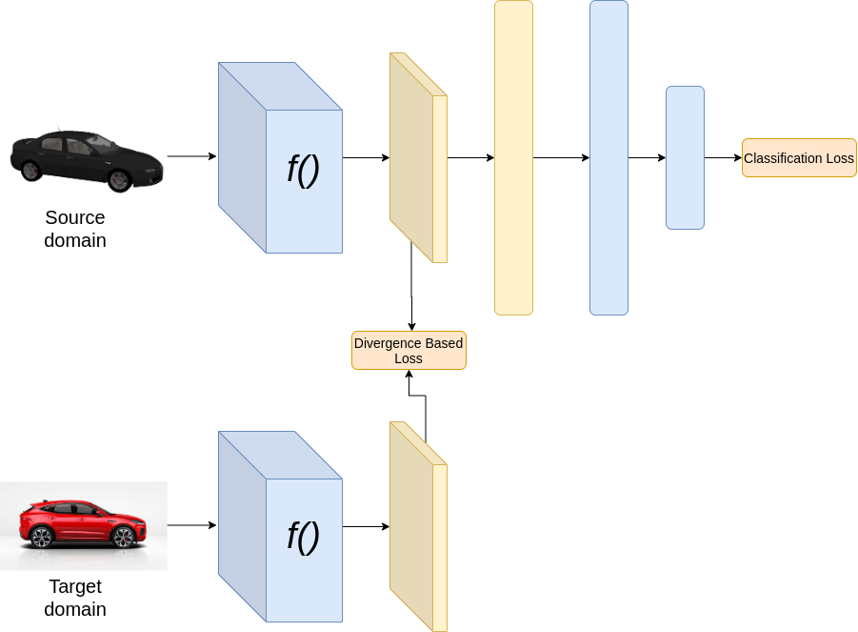
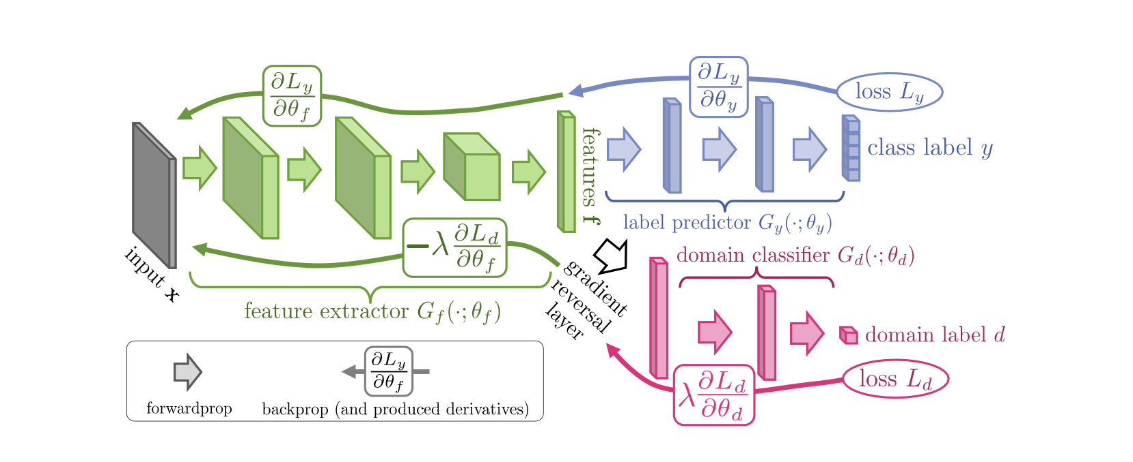
Domain Adaptation approaches so far:
Divergence based Methods
Domain Adversarial Learning
Self-Supervised Task
Introduction
Method
Results
Related work
Conclusion
4

Slide 5
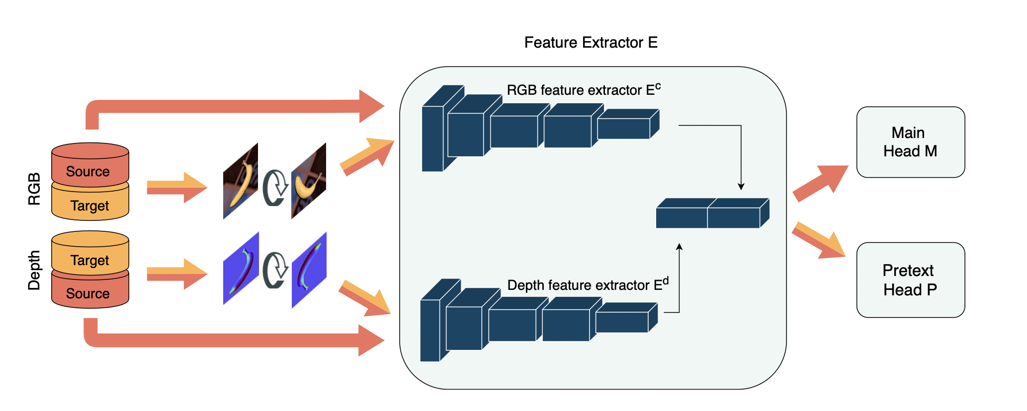
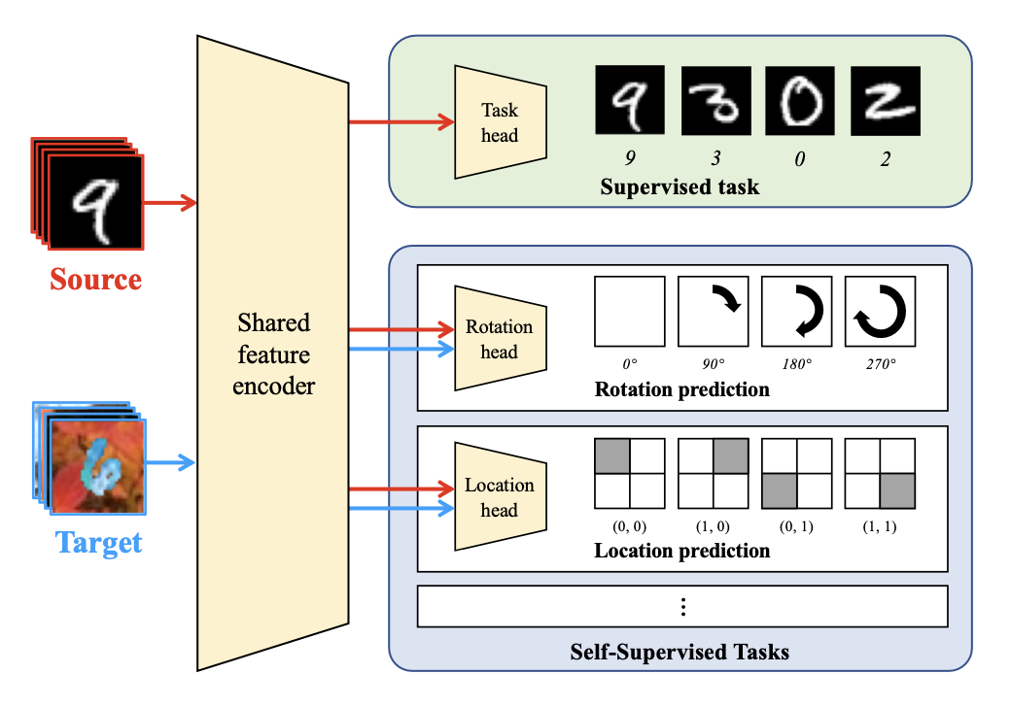
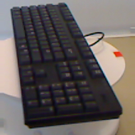
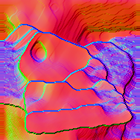
Main contributions
This paper is directly derived from two different approaches:
Loghmani et al. (2020)
Sun et al . (2019)
Introduction
Method
Results
Related work
Conclusion
?
What are depth images?
5

Slide 6
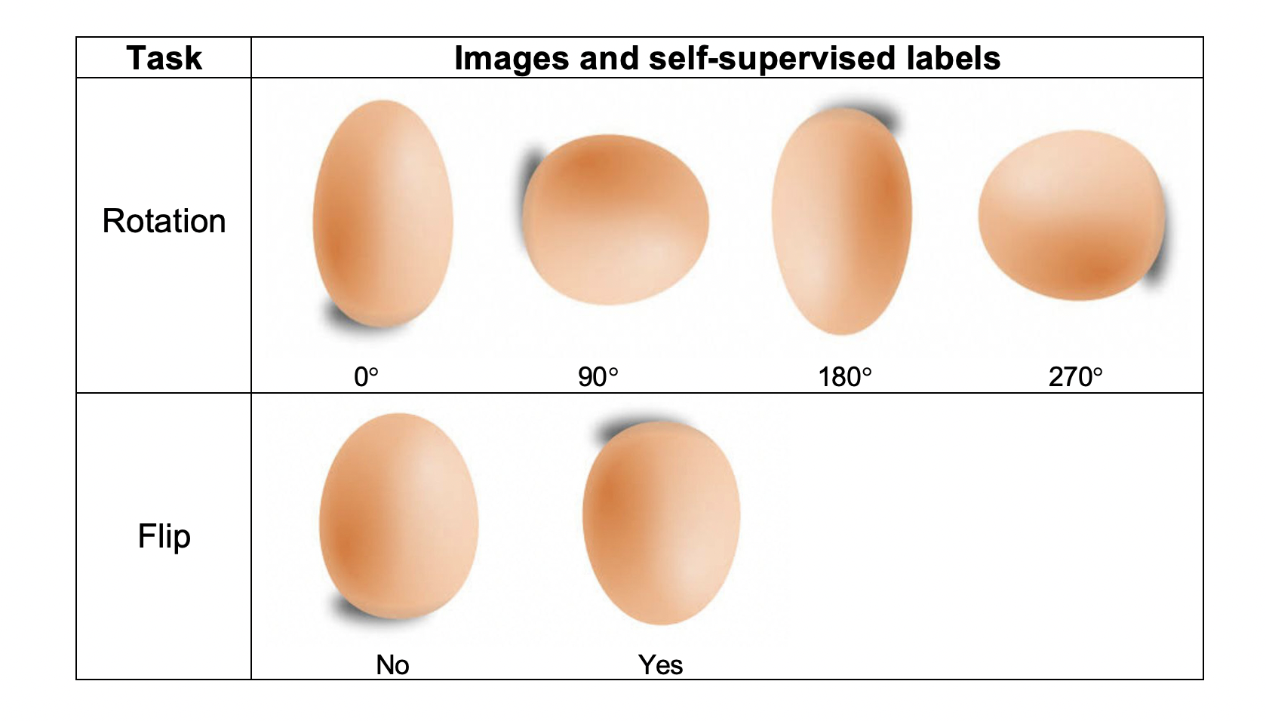
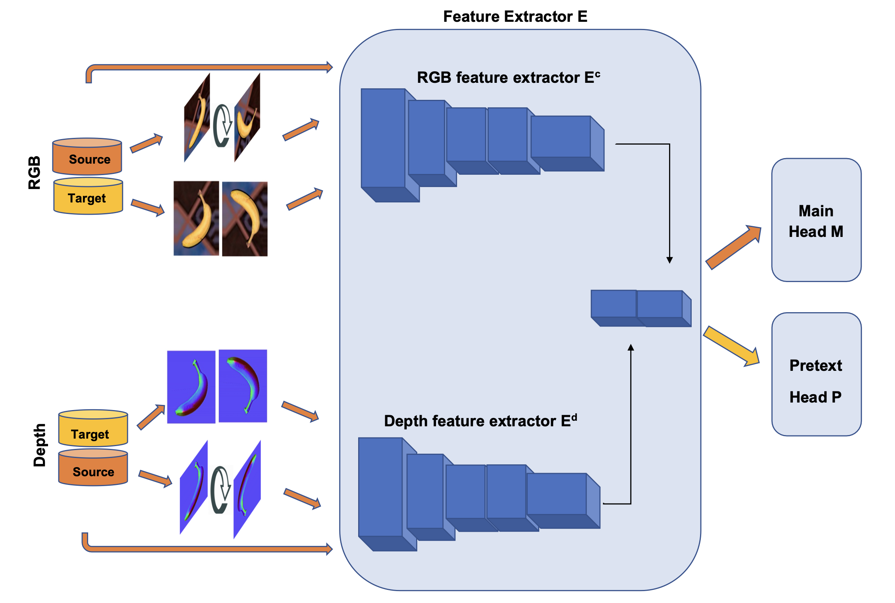
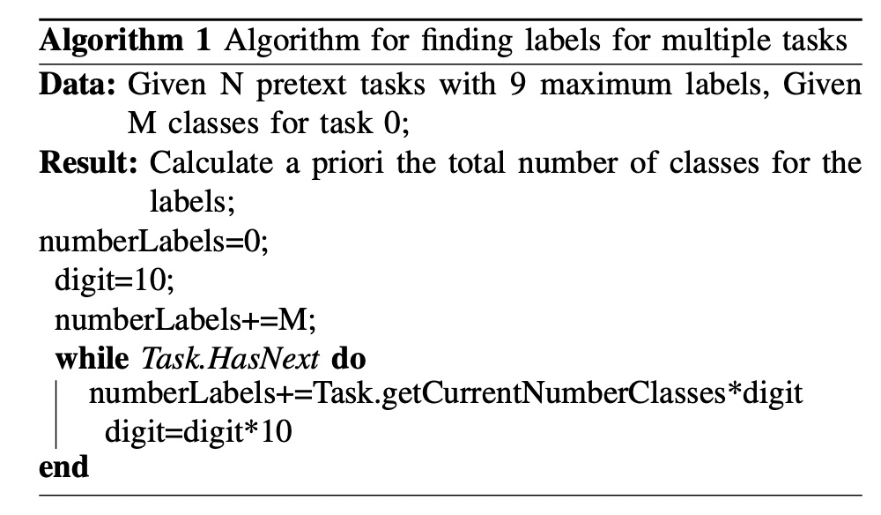
Architecture
Introduction
Method
Results
Related work
Conclusion
6

Slide 7
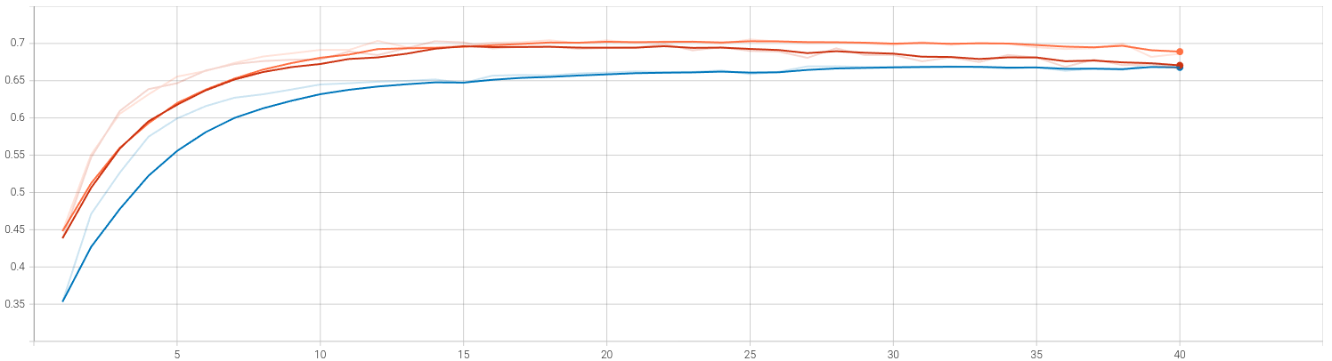
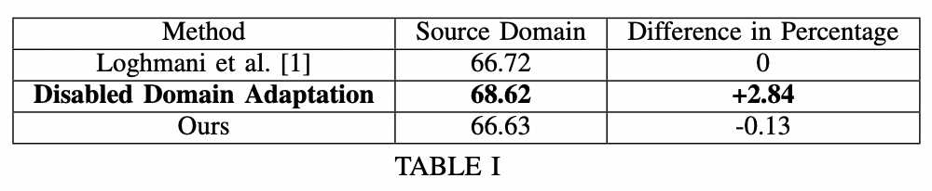
Results on Source Domain
Accuracy
#Epochs
Loghmani et al. | Blue
D.D.A. | Orange
Ours | Red
Introduction
Method
Results
Related work
Conclusion
7

Slide 8
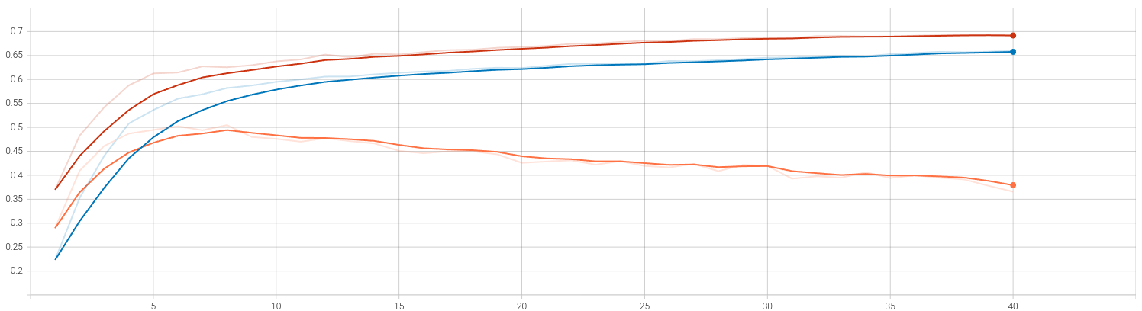
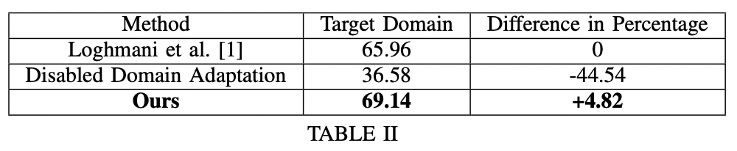
Results on Target Domain
Accuracy
#Epochs
Loghmani et al. | Blue
D.D.A. | Orange
Ours | Red
Introduction
Method
Results
Related work
Conclusion
8

Slide 9
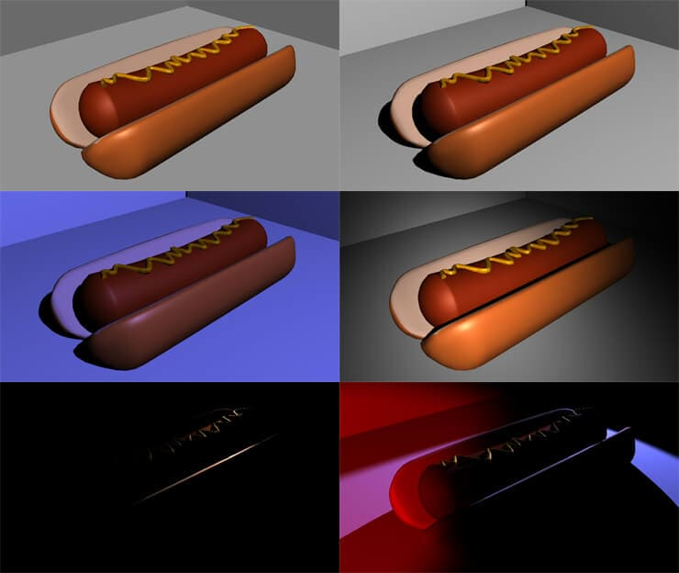
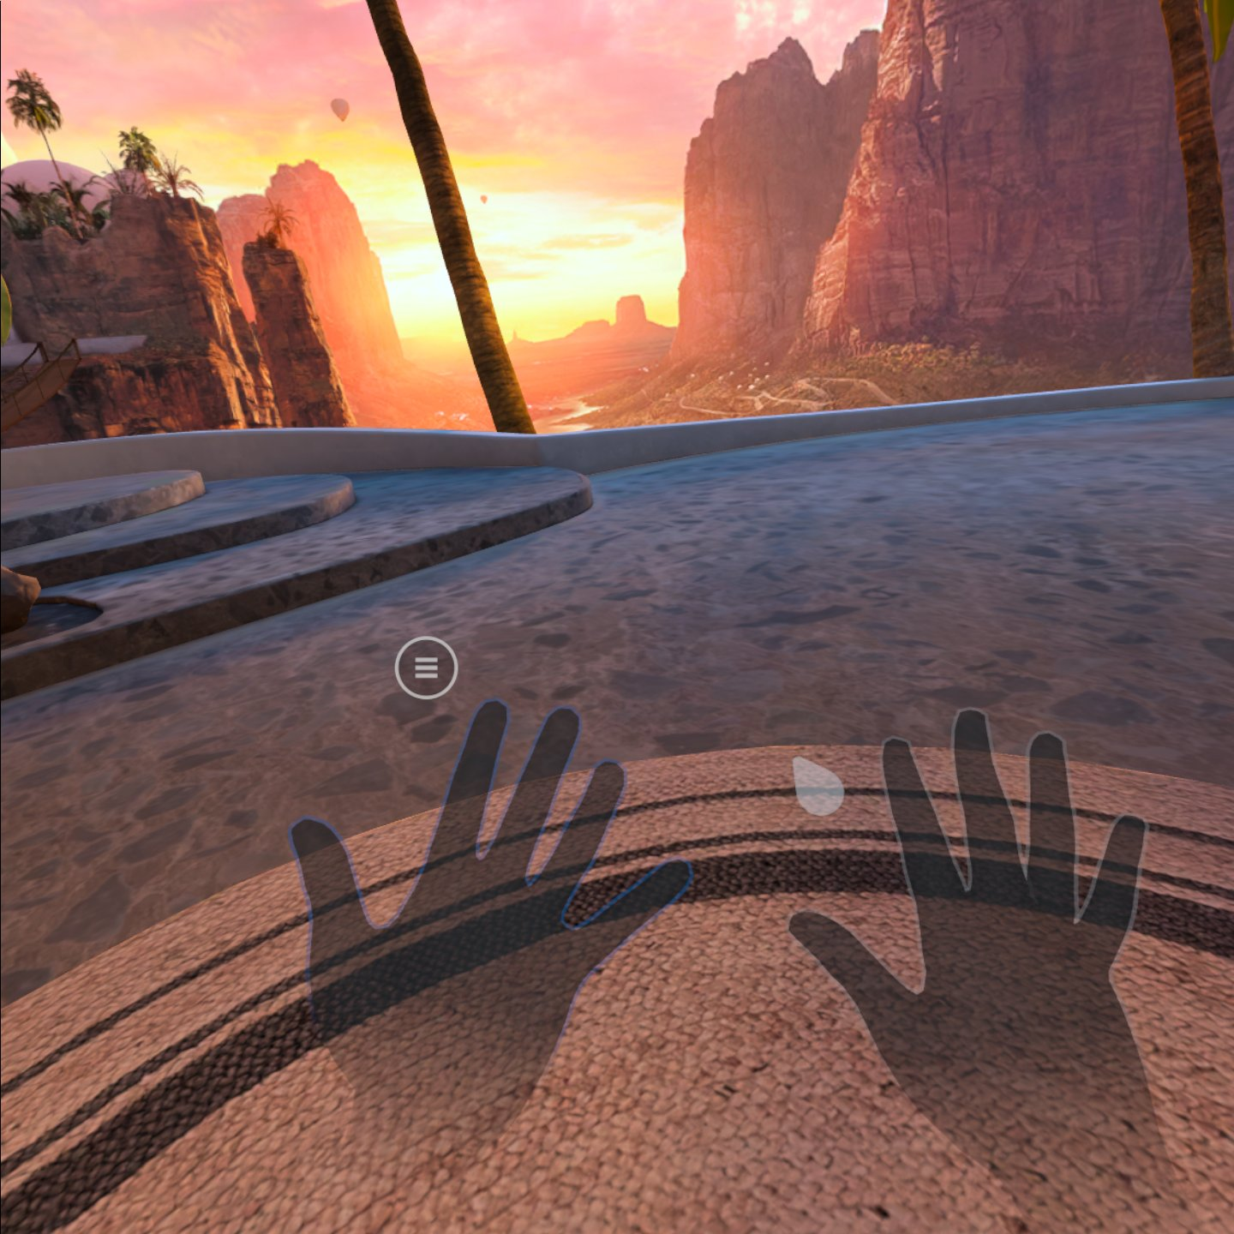
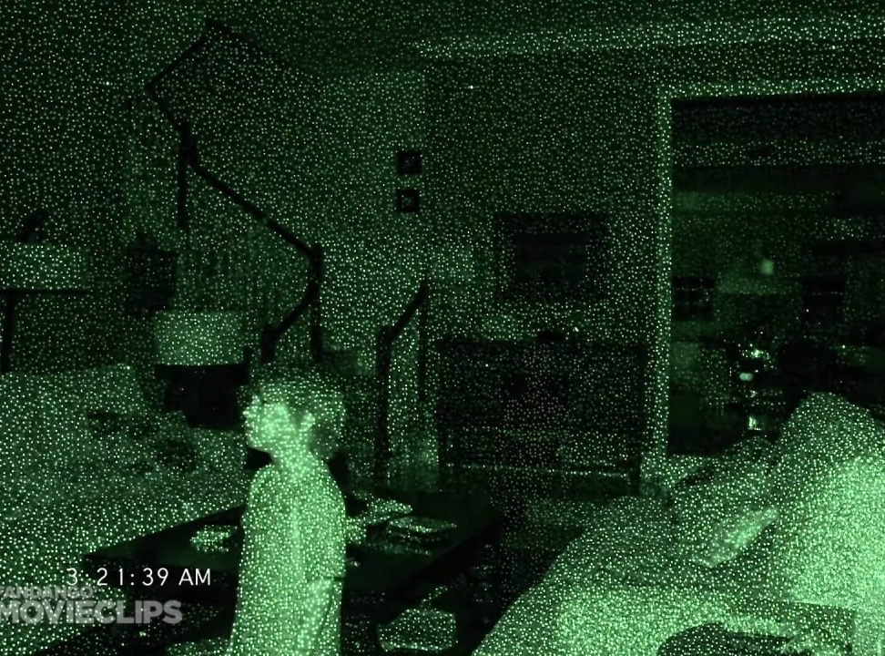
Conclusion
Introduction
Method
Results
Related work
Conclusion
9

Slide 10
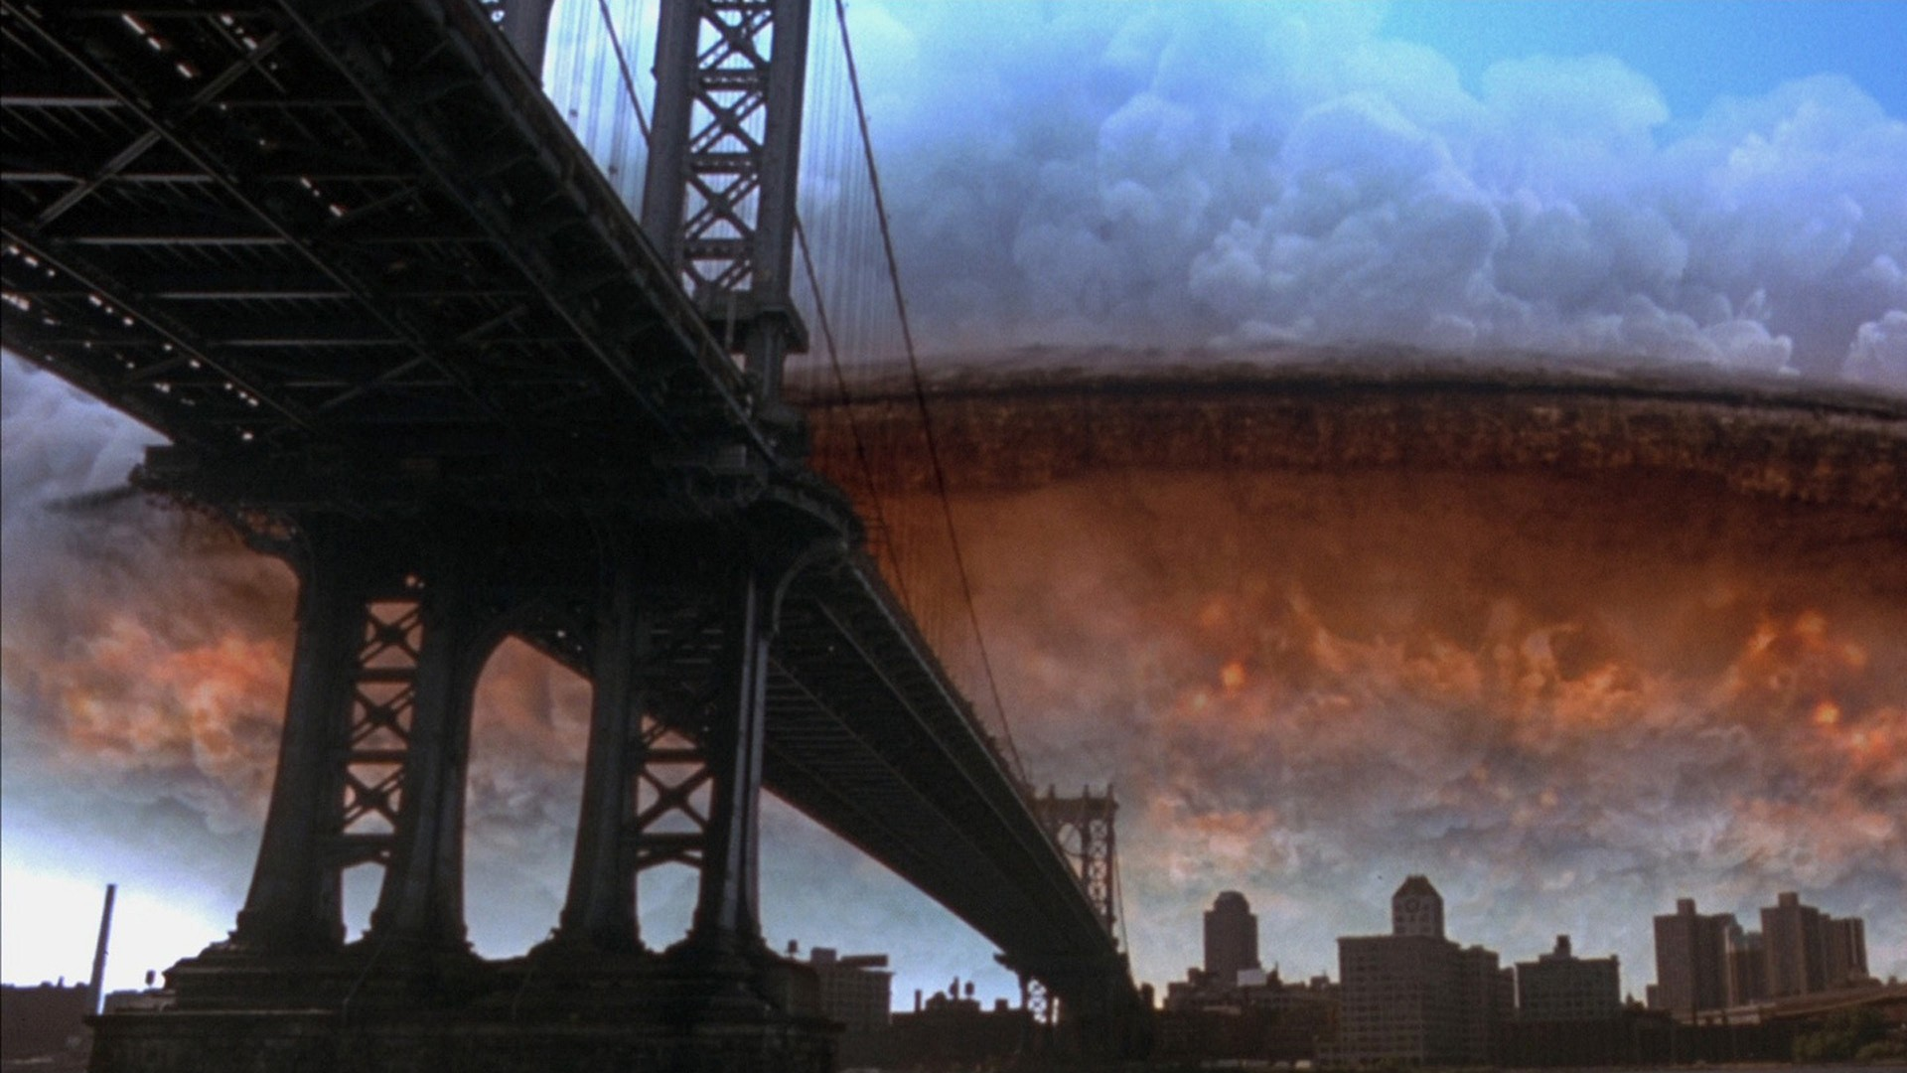
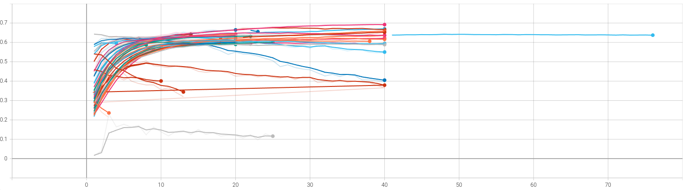
Conclusion
Optimization Testing
Introduction
Method
Results
Related work
Conclusion
10

Slide 11
THANKS FOR YOUR ATTENTION! Gaetano Salvatore Falco Kuerxi Gulisidan
11

